Slide 1
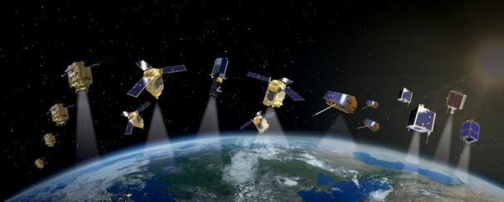
reconnaissance using image segmentation

Slide 2
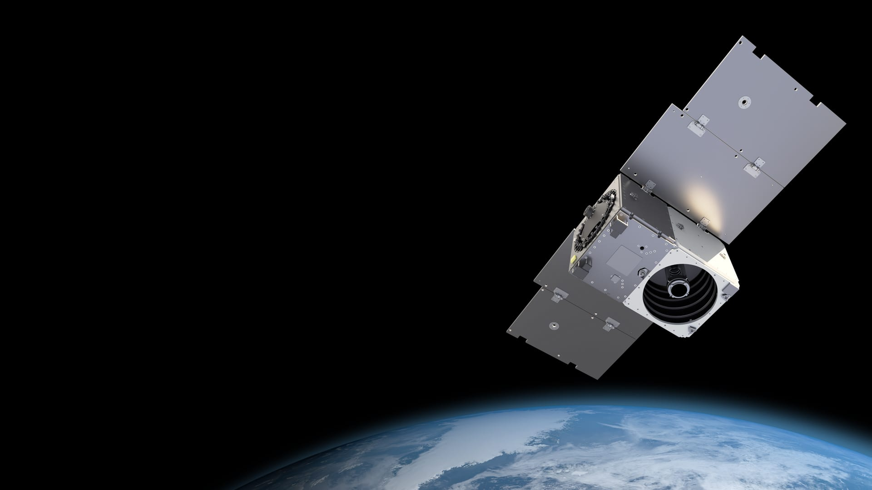
Outline
Introduction
Problem Statement
Methodology
Dataset
Architecture
Modelling
Evaluation and Results

Slide 3
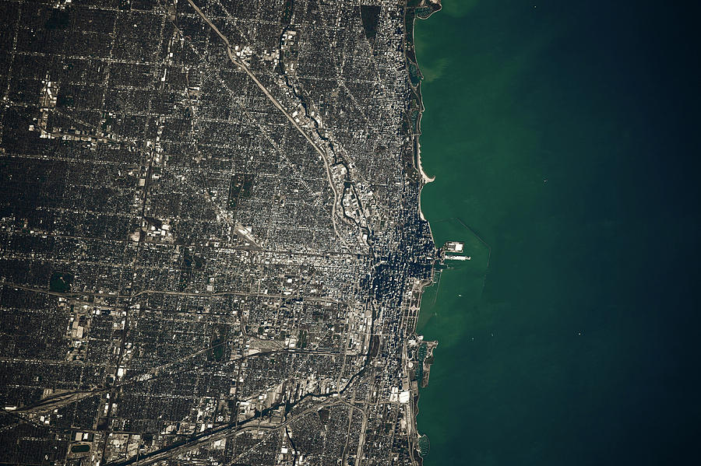
INTRODUCTION
Space technologies can give operational advantage over potential adversaries. In predominant areas like defense and science, advance space engineering requires an automatic feature labelling system to accurately classify features in overhead imagery which helps in effective satellite intelligence and surveillance from space. Using computer vision, we can also orchestrate responses to future threats and opportunities with enhanced and affordable defense and security capability.

Slide 4
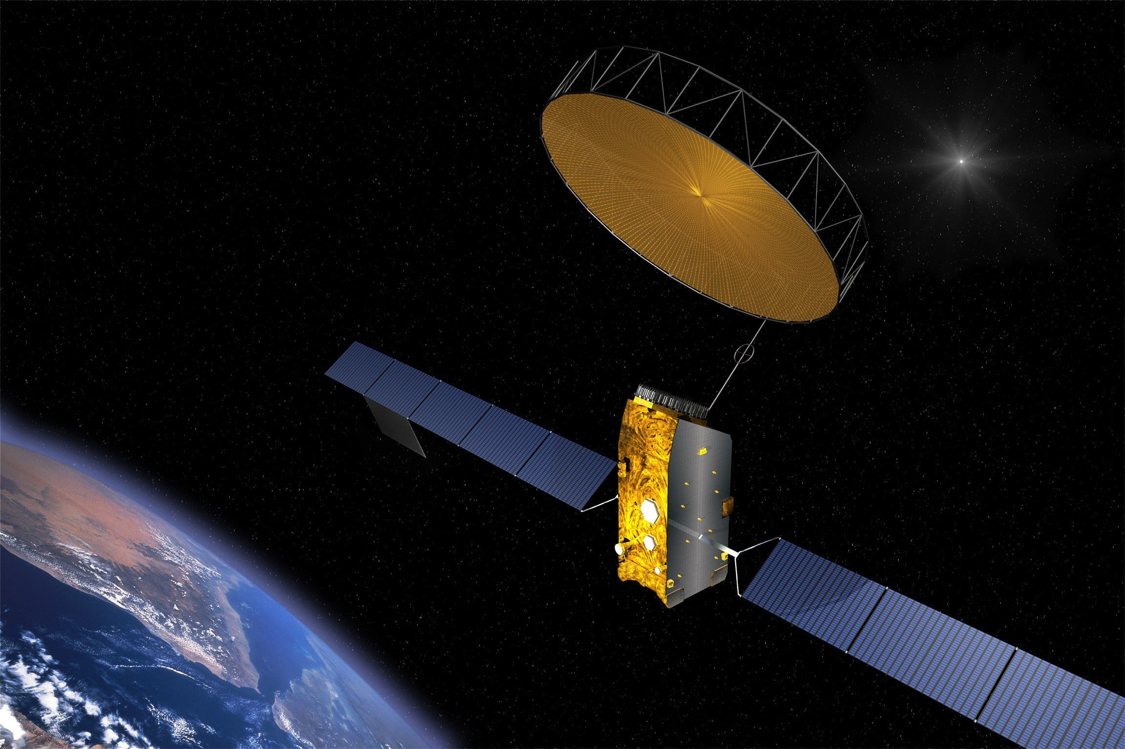
PROBLEM STATEMENT
Reconnaissance or scouting is the exploration of an area by military forces to obtain information about enemy forces, terrain, and other activities. Automatic feature labelling will enhance the visual learning of the region and make smart decisions in defense sector.

Slide 5
METHODOLOGY
Results &
Evaluation
Data
Preprocessing
Data
Augmentation
Modelling
Roster
images
Masks
UNet
SegNet
Polygon WKT
Rescaling

Slide 6
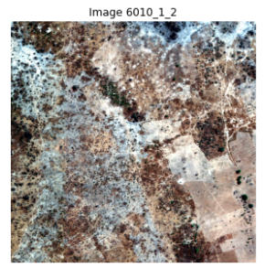
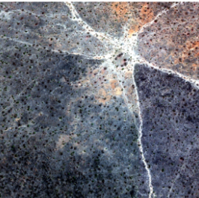
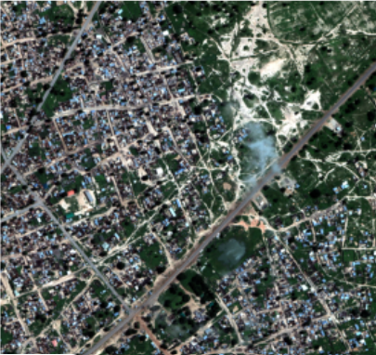
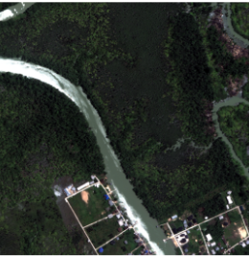
DATASETS
The dataset consists of
3- Band Images - RGB natural color images
16 Band Images - Multispectral (400 – 1040nm) and short-wave infrared (1195-2365nm) range.
Grid_sizes – Xmin and Y max coordinates of each image
Polygon_wkt – Classes and polygon coordinates

Slide 7
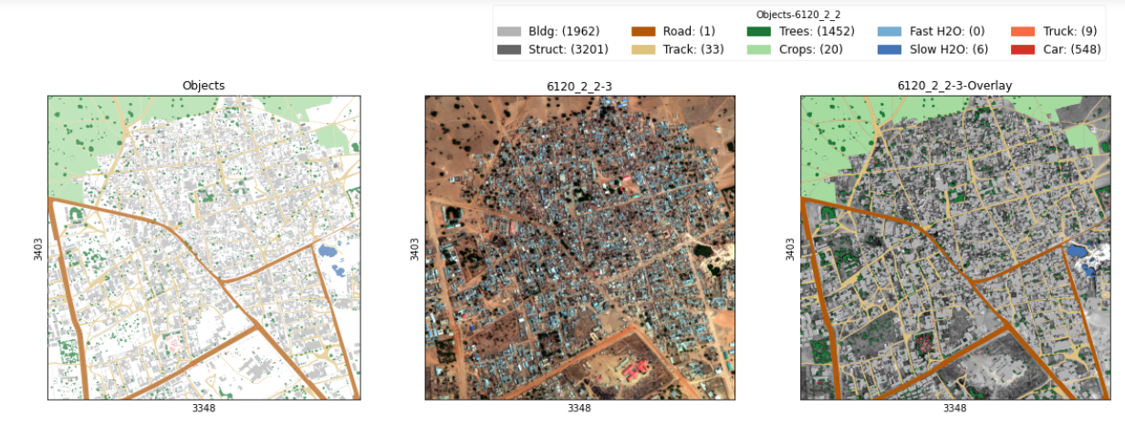
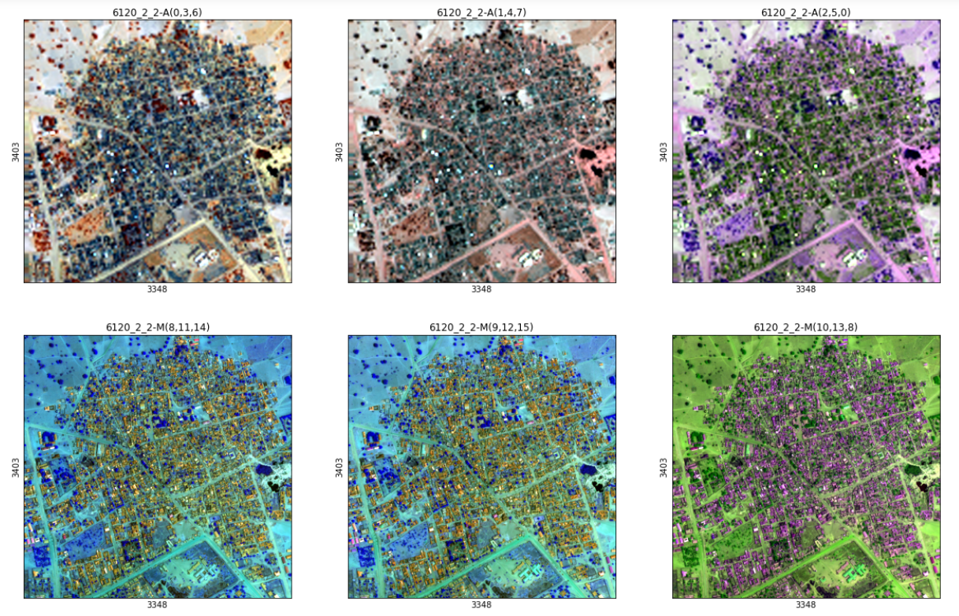
DATASET VISUALIZATION
Buildings
Misc. Manmade structures
Road
Track
Trees
Crops
Waterway
Standing water
Vehicle Large
Vehicle Small

Slide 8
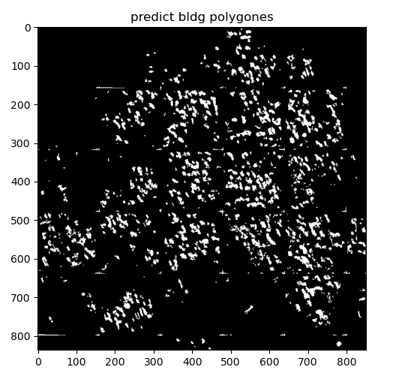
DATA PRE-PROCESSING
The images are resized to Xmin, Ymax to eliminate unnecessary data.
The masks are generated by taking the class id and the polygon is generated.
We would be generating 10 masks for each image.
Data augmentation

Slide 9
IMAGE SEGMENTATION APPROACHES
U-NET
The network is based on the fully convolutional network and its architecture was modified and extended to work with fewer training images and to yield more precise segmentations.
SEGNET
This core trainable segmentation engine consists of an encoder network, a corresponding decoder network followed by a pixel-wise classification layer.

Slide 10
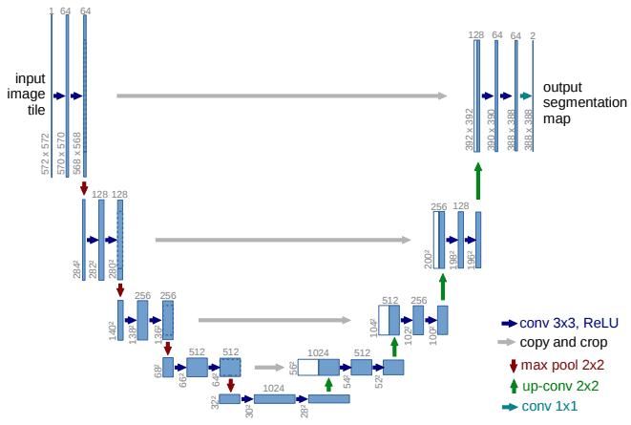
UNET
The U-Net architecture is built upon the Fully Convolutional Network.
The U-Net owes its name to its symmetric shape, which is different from other FCN variants.
Optimizer – Adam
Learning Rate – 1e-4
Loss – Binary cross entropy
Activation – Sigmod

Slide 11
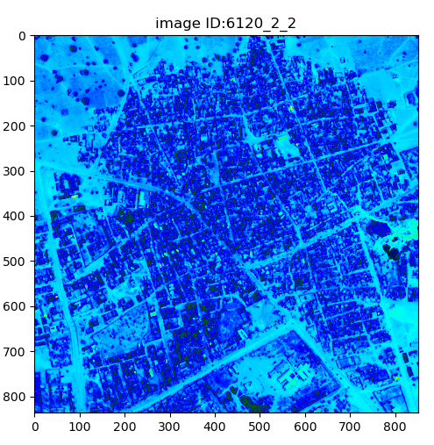
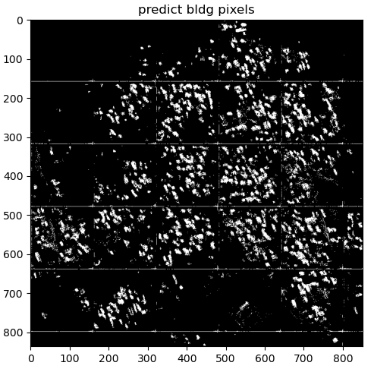
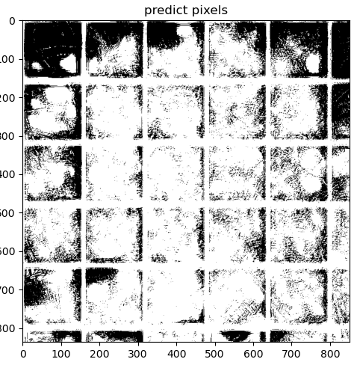
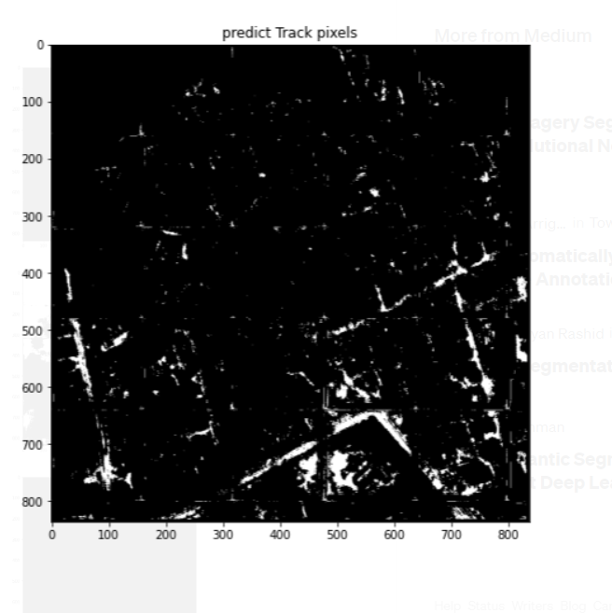
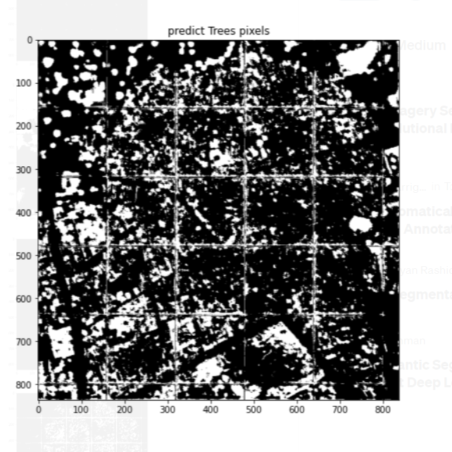
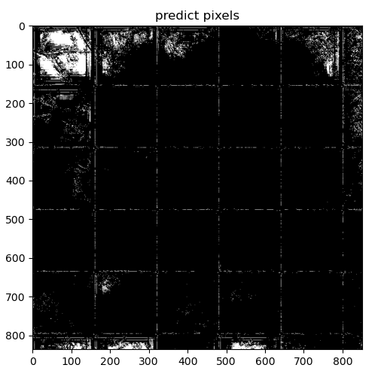
RESULTS
Metrics | Score
Jaccard coefficient | 0.35
Batch size | 64
Time | 17 hours

Slide 12
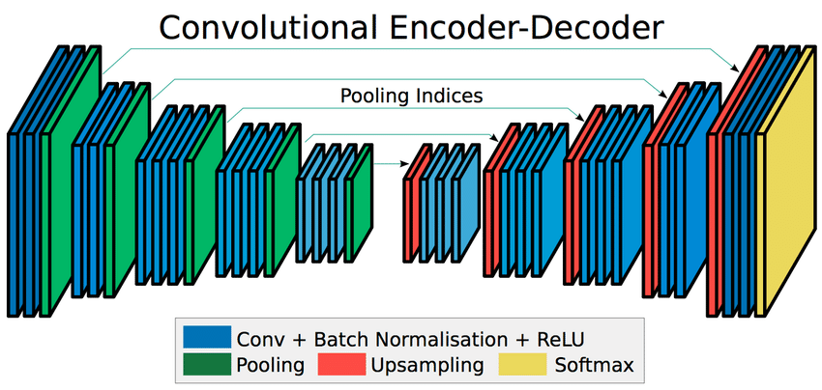
SEGNET
Segnet consists of sequence of processing layers (encoders) followed by a corresponding set of decoders for a pixelwise classification.
One key feature of SegNet is that it retains high frequency details in the segmented image as the pooling indices of encoder network is connected to pooling indices of decoder networks.
Optimizer – Adam
Learning Rate – 1e-4
Loss – Binary cross entropy
Activation – Softmax

Slide 13
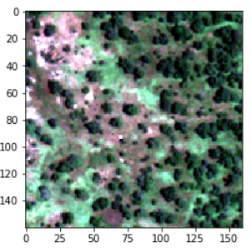
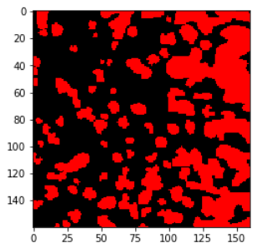
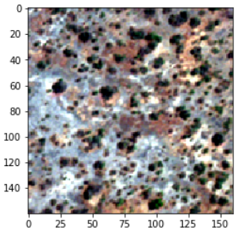
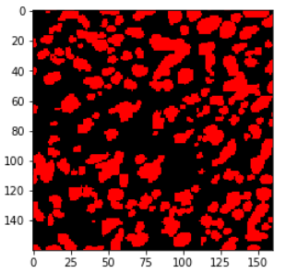
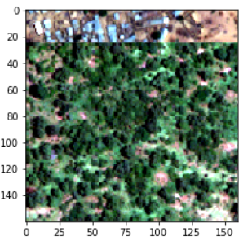
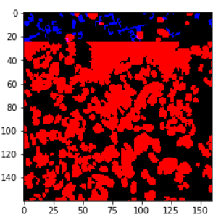
RESULTS
Metrics | Score
Jaccard coefficient | 0.31
epochs | 64
Time | 48 hours

Slide 14
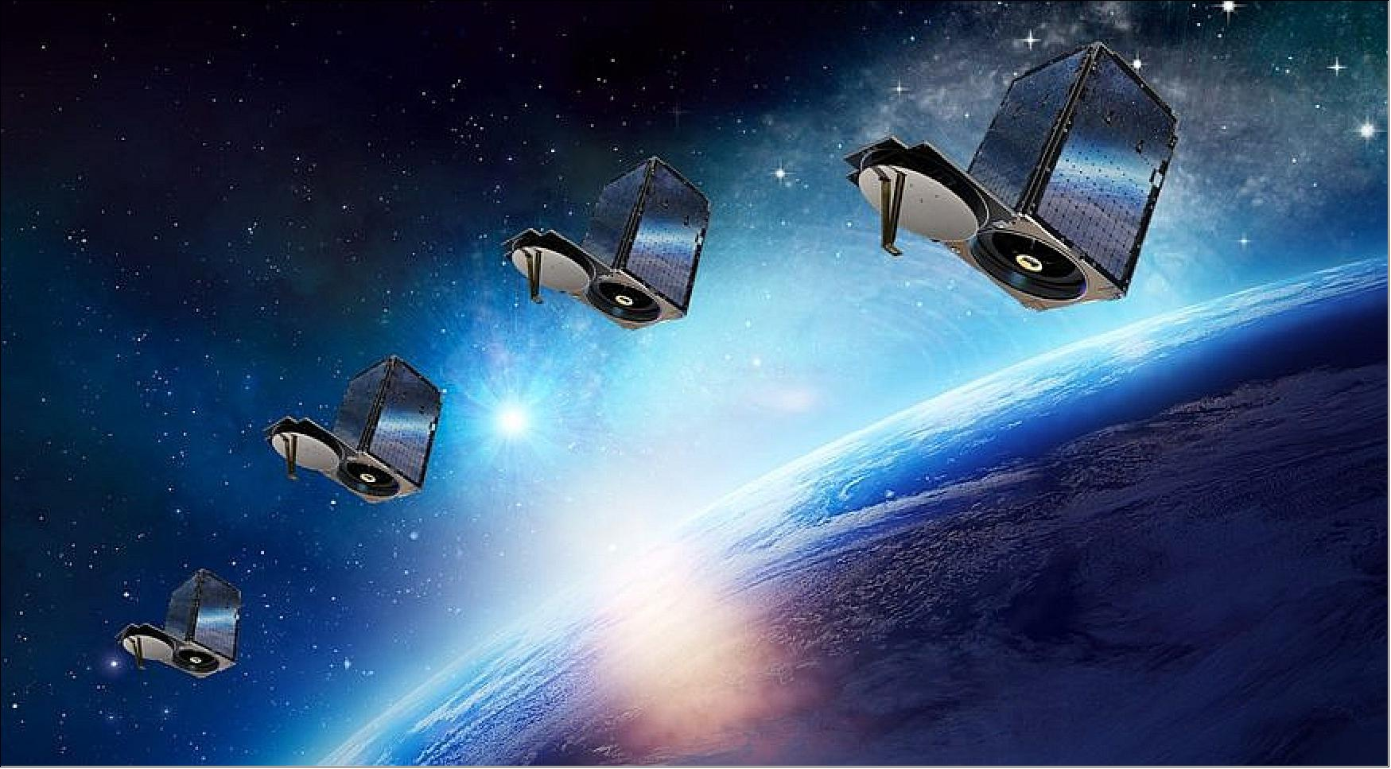
CONCLUSION
Given the small size of the dataset and tedious processing , this project has been a challenging one.
The training has been brute force and we were able to learn about each algorithm in detail.

Slide 15
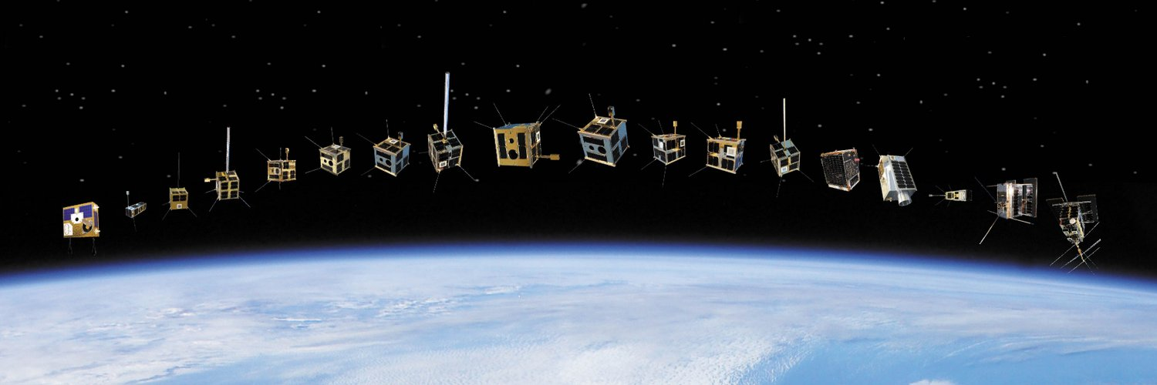
THANKYOU!

